Slide 1

Making Multi-Cluster as Easy as Single Cluster
An Open Source Project from IBM Research

Slide 2
Why KubeStellar?
KubeStellar makes it easy to configure and run applications across multiple clusters
It’s as easy as a single cluster
It works with the tools that you are used to
Join the community!
If are deploying in 1 cluster and want an easy way to use 2+ clusters
You are using multiple clusters and want an easier developer experience

Slide 3
We all need multiple clusters
To separate environments (dev, test, staging)
To isolate groups, teams or departments
To meet enterprise security or data governance requirements
For availability of resources
To access heterogenous resources
For running applications on the edge, including in disconnected environments

Slide 4
The KubeSteller Point-of-View
We make 2+ clusters feel like 1 cluster for developers with a flexible way to define service inventory
Under the covers, KubeStellar deploys and runs applications across multiple clusters
KubeStellar is architected to work with all Kubernetes tooling
This slide is a dupe of slide 2 – not sure we need it

Slide 5
Demo Slides

Slide 6
KubeStellar Value
KubeStellar is useful for bridging the gap between single and multi-cluster deployment and configuration of cloud-native projects/products/solutions
1. Cloud-native projects that are already multi-cluster enabled (Loki, Prometheus) can be easily deployed and configured with KubeStellar’s customization feature
2. Cloud-native projects that lack multi-cluster support can be enhanced with KubeStellar to unlock multi-cluster operation. If you need multi-cluster support from an existing single-cluster project, KubeStellar can enable multi-cluster operation

Slide 7


Demonstration with partners in the community
ArgoCD
PyTorch
KFP
Kueue
Helm
Kubectl
Kustomize

Slide 8
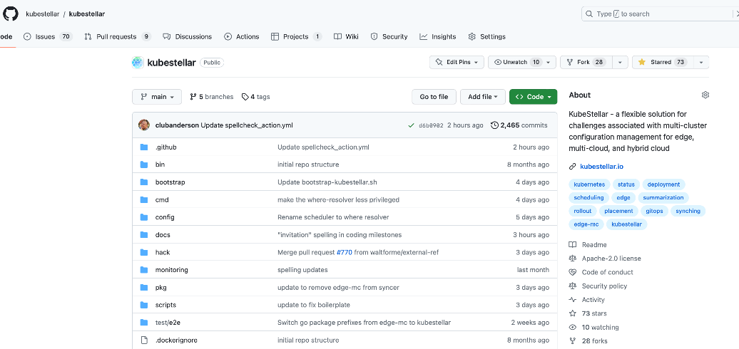
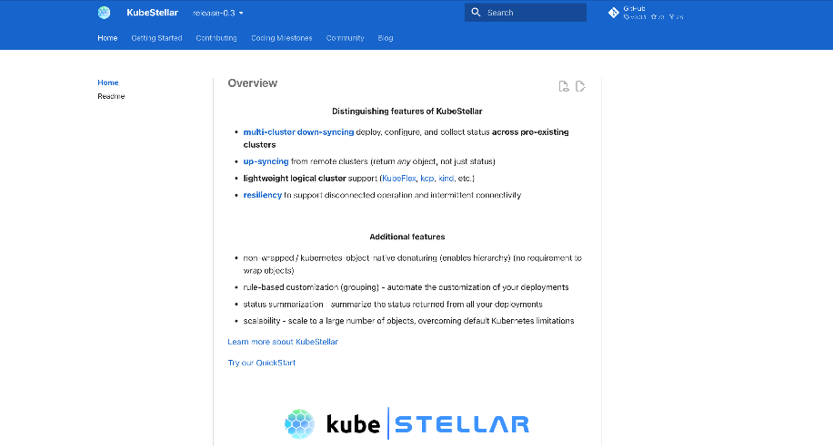
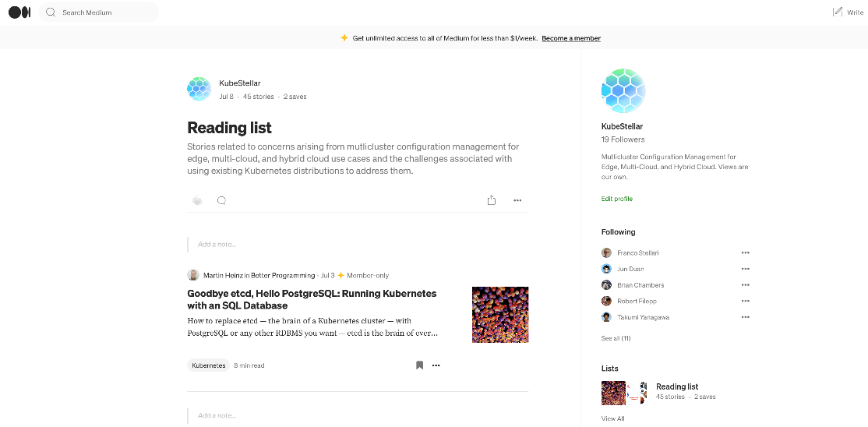
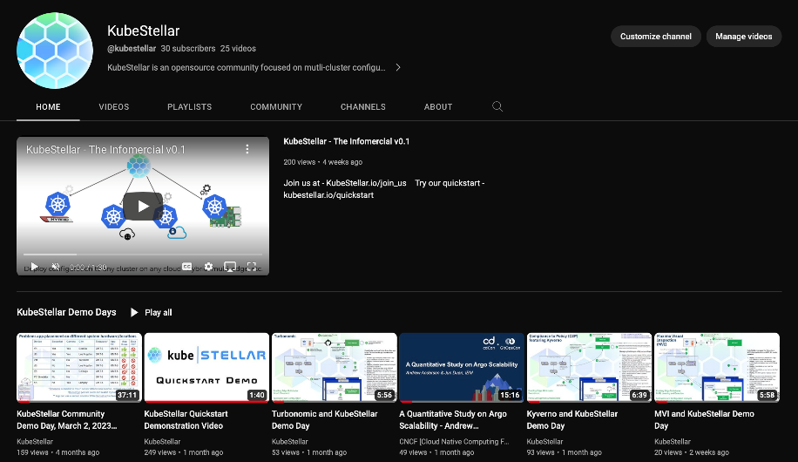
Code: kubestellar.io/code
Documentation: kubestellar.io
Find us on….
Blogs: kubestellar.io/blog
Multimedia: kubestellar.io/tv

Slide 9



Multi-Cluster Queuing and Scheduling MCAD
Braulio, Franco TODO
Turbo Services
KubeStellar deploys Turbo Edge App and helps Turbo execute app moves cross clusters:
​Enable: App developer pushes Turbo Edge Apps installation manifest to GitHub.
​Deploy: kbuestellar-syncer to install Turbo Edge.
​Update: kubestellar-syncer deploys managed workload on cluster A.
​Collect: Turbo Edge Apps send collected topology and metrics to Turbo Services.
​Enable: Turbo Services run analysis and send back actions.
​Enable: Actions such as container pod moves within the cluster are executable by the edge app and will go there directly. Actions such as container resize, and horizontal scaling require updating the spec in the source of truth in GitHub. Cross-cluster app move actions further require a multi-cluster manager such as KubeStellar to facilitate the execution.
​Enable: Scheduling decision is captured in a updated EdgePlacement object. Argo CD delivers this EdgePlacement object to WMW.
​Enable: EdgePlacement received, and workload deployed to cluster B.
KubeStellar
IMW
ESP
WMW
MW
Edge Location B
Edge Location A
2
Install Turbo Edge App
syncer
Turbo Edge App
(Kubeturbo)
Enabling Edge Multicluster
Smart Placement
Application and Configuration Lifecycle Management w/KubeStellar
KubeStellar-syncer
Turbo Edge App
(Kubeturbo)
3
Install Managed Workload
https://ibm.box.com/s/fvo0v3q91exedf2f3r94wqb26kwgd61t

Slide 10

Software Defined Agriculture
Gloire, Braulio TODO
Turbo Services
Topology stitched, analysis run,
and recommended actions generated
5
deploy new edge placement for executing
Turbo’s recommendations
Actions via GitHub source, e.g.,
Cross-cluster app moves
Container horizontal scaling
Container resize
7
KubeStellar deploys Turbo Edge App and helps Turbo execute app moves cross clusters:
​Enable: App developer pushes Turbo Edge Apps installation manifest to GitHub.
​Deploy: kubestellar-syncer to install Turbo Edge.
​Update: kubestellar-syncer deploys managed workload on cluster A.
​Collect: Turbo Edge Apps send collected topology and metrics to Turbo Services.
​Enable: Turbo Services run analysis and send back actions.
​Enable: Actions such as container pod moves within the cluster are executable by the edge app and will go there directly. Actions such as container resize, and horizontal scaling require updating the spec in the source of truth in GitHub. Cross-cluster app move actions further require a multi-cluster manager such as KubeStellar to facilitate the execution.
​Enable: Scheduling decision is captured in a updated EdgePlacement object. Argo CD delivers this EdgePlacement object to WMW.
​Enable: EdgePlacement received, and workload deployed to cluster B.
6
KubeStellar
Actions executable directly via the edge app
Move containers within the cluster
Provision / suspend / move / resize infra if supported
IMW
ESP
WMW
4
MW
Topology / Metrics
8
Receives New placement
Edge Location B
Edge Location A
2
2
Install Turbo Edge App
syncer
Install Turbo Edge App
Turbo Edge App
(Kubeturbo)
Enabling Edge Multicluster
Smart Placement
Application and Configuration Lifecycle Management w/KubeStellar
KubeStellar-syncer
Turbo Edge App
(Kubeturbo)
3
3
Install Managed Workload
Install Managed Workload
https://ibm.box.com/s/fvo0v3q91exedf2f3r94wqb26kwgd61t

Slide 11

Cost-Efficient AI Training
Aashni
Jun TODO
TRESTLE
C2P
Managing the lifecycle of Kyverno at Edge:
​Deploy: Security auditor builds OSCAL artifacts (standard format for representing compliance) indicating Kyverno install and Kyverno policies by TRESTLE and deploy C2P CR with embedding the OSCAL artifacts
​Deploy: C2P computes required k8s resources (install manifest, policies, etc.) from the CR
​Deploy: C2P deploys Kyverno install manifest, and policies to Workload Management Workspace (WMW) with EdgePlacement
​Update: KubeStellar-Syncer receives Kyverno install manifest and the new or updated Kyverno policies
​Update: KubeStellar-syncer deploys the received objects to Edge location. Kyverno Policy Engine scans based on deployed policies
​Update: Kyverno Policy Engine generates reports on regular basis
​Collect: Policy reports are sent back to mailbox workspaces using up-syncing.
​Collect: C2P User Interface collects them from KubeStellar and can provide compliance summary for a multicluster
environment.
KubeStellar
IMW
ESP
WMW
One C2P CR is corresponding to one WMW
MW
Edge Location B
Edge Location A
Install Turbo Edge App
syncer
Turbo Edge App
(Kubeturbo)
Enabling Edge Multicluster
Compliance
Policy Management w/KubeStellar
3
Install Managed Workload
Kyverno Policy
Engine
KubeStellar-Syncer

Slide 12




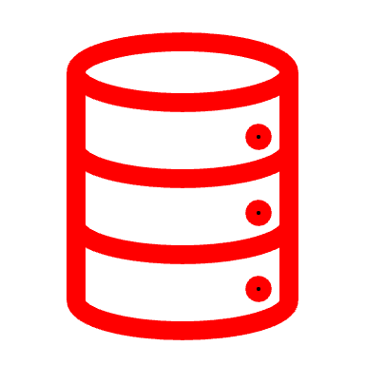
Geo-Distributed Data Flows – Octopus and Turbonomic
Braulio,
Jun TODO
App admin applies manifest with Functional DAG with SLOs / constraints
label
filter
agg
persist
Hub operator at control site decomposes DAG CRD
into spoke/cluster level DAGlets. This is synched back to KubeStellar
KubeStellar-syncer
Control Site
KubeStellar manages the lifecycle of Octopus App
​Deploy: functional DAG with SLOs / constraints is submitted to KubeStellar WMWs.
​Enable: hub operator at control site pulls DAG and decomposes DAG into spoke/cluster level DAGlets
Enable: hub operator push DAGlets to KubeStellar WMWs
​Deploy: DAGLets are transferred to spoke controllers running at each worker site via the KubeStellar-syncer
Hub Operator
1
Deploy DAG
2
KubeStellar
Operator DAG
*Hub discovers site-level topology
IMW
IMW
3
IMW
ESP
IMW
IMW
WMW
Worker Site (Cloud)
etcd
Topology / Metrics
IMW
4
DAGlets
KubeStellar-syncer
Spoke
Operator
IMW
MW
Persist local Op
`
4
Edge Location B
`
DAGlets
Spoke Operator
Edge Location A
Enabling Edge Multicluster
Observability
Enabling Edge Multicluster
Smart Placement
KubeStellar-syncer
etcd
Apache Spark Streaming ODDAGlet realization
Prometheus source
Prom Filter
Data Op
Prom stream out Op
Worker Site (Edge)

Slide 13


Interplanetary Workload Distribution
Kevin TODO
Turbo Services
KubeStellar deploys Turbo Edge App and helps Turbo execute app moves cross clusters:
​Enable: App developer pushes Turbo Edge Apps installation manifest to GitHub.
​Deploy: kbuestellar-syncer to install Turbo Edge.
​Update: kubestellar-syncer deploys managed workload on cluster A.
​Collect: Turbo Edge Apps send collected topology and metrics to Turbo Services.
​Enable: Turbo Services run analysis and send back actions.
​Enable: Actions such as container pod moves within the cluster are executable by the edge app and will go there directly. Actions such as container resize, and horizontal scaling require updating the spec in the source of truth in GitHub. Cross-cluster app move actions further require a multi-cluster manager such as KubeStellar to facilitate the execution.
​Enable: Scheduling decision is captured in a updated EdgePlacement object. Argo CD delivers this EdgePlacement object to WMW.
​Enable: EdgePlacement received, and workload deployed to cluster B.
KubeStellar
IMW
ESP
WMW
MW
Edge Location B
Edge Location A
2
Install Turbo Edge App
syncer
Turbo Edge App
(Kubeturbo)
Enabling Edge Multicluster
Smart Placement
Application and Configuration Lifecycle Management w/KubeStellar
KubeStellar-syncer
Turbo Edge App
(Kubeturbo)
3
Install Managed Workload
https://ibm.box.com/s/fvo0v3q91exedf2f3r94wqb26kwgd61t

Slide 14




Interplanetary Workload Distribution
KubeStellar deploys and manages workloads on orbital locations (e.g., satellites) and corresponding data processing on Space Data Center (SDC).
Uplink/Configure: Developer transmits configuration/repository images to SDC via ground station
Deploy: KubeStellar establishes syncers on execution clusters and SDC as required
Space Data Center (SDC)
KubeStellar
IMW
ESP
WMW
Orbital Location A
KubeStellar-syncer
MW
SDC Clusters
KubeStellar-syncer
Orbital Location B
KubeStellar-syncer

Slide 15
Interplanetary Workload Distribution
KubeStellar deploys and manages workloads on orbital locations (e.g., satellites) and corresponding data processing on Space Data Center (SDC).
Uplink/Configure: Developer transmits configuration/repository images to SDC via ground station
Deploy: KubeStellar establishes syncers on execution clusters and SDC as required
Deploy: syncers deploy workloads on orbital locations, corresponding data handlers on SDC, plus transceiver workload
Space Data Center (SDC)
KubeStellar
IMW
ESP
WMW
Orbital Location A
KubeStellar-syncer
Orbital Probe Workload A
MW
SDC Clusters
KubeStellar-syncer
Orbital Location B
Transceiver Workload
KubeStellar-syncer
Orbital Probe Workload B
Data Handler A
Data Handler B

Slide 16
Interplanetary Workload Distribution
KubeStellar deploys and manages workloads on orbital locations (e.g., satellites) and corresponding data processing on Space Data Center (SDC).
Uplink/Configure: Developer transmits configuration/repository images to SDC via ground station
Deploy: KubeStellar establishes syncers on execution clusters and SDC as required
Deploy: syncers deploy workloads on orbital locations, corresponding data handlers on SDC, plus transceiver workload
Operation: Orbital workloads transmit to corresponding data handlers when in range
Space Data Center (SDC)
KubeStellar
IMW
ESP
WMW
Orbital Location A
KubeStellar-syncer
Orbital Probe Workload A
MW
SDC Clusters
KubeStellar-syncer
Orbital Location B
Transceiver Workload
KubeStellar-syncer
Orbital Probe Workload B
Data Handler A
Data Handler B

Slide 17
Interplanetary Workload Distribution
KubeStellar deploys and manages workloads on orbital locations (e.g., satellites) and corresponding data processing on Space Data Center (SDC).
Uplink/Configure: Developer transmits configuration/repository images to SDC via ground station
Deploy: KubeStellar establishes syncers on execution clusters and SDC as required
Deploy: syncers deploy workloads on orbital locations, corresponding data handlers on SDC, plus transceiver workload
Operation: Orbital workloads transmit to corresponding data handlers when in range
Space Data Center (SDC)
KubeStellar
IMW
ESP
WMW
Orbital Location A
KubeStellar-syncer
Orbital Probe Workload A
MW
SDC Clusters
KubeStellar-syncer
Transceiver Workload
Data Handler A
Data Handler B

Slide 18
Interplanetary Workload Distribution
KubeStellar deploys and manages workloads on orbital locations (e.g., satellites) and corresponding data processing on Space Data Center (SDC).
Uplink/Configure: Developer transmits configuration/repository images to SDC via ground station
Deploy: KubeStellar establishes syncers on execution clusters and SDC as required
Deploy: syncers deploy workloads on orbital locations, corresponding data handlers on SDC, plus transceiver workload
Operation: Orbital workloads transmit to corresponding data handlers when in range
Space Data Center (SDC)
KubeStellar
IMW
ESP
WMW
MW
SDC Clusters
KubeStellar-syncer
Orbital Location B
Transceiver Workload
KubeStellar-syncer
Orbital Probe Workload B
Data Handler A
Data Handler B

Slide 19
Interplanetary Workload Distribution
KubeStellar deploys and manages workloads on orbital locations (e.g., satellites) and corresponding data processing on Space Data Center (SDC).
Uplink/Configure: Developer transmits configuration/repository images to SDC via ground station
Deploy: KubeStellar establishes syncers on execution clusters and SDC as required
Deploy: syncers deploy workloads on orbital locations, corresponding data handlers on SDC, plus transceiver workload
Operation: Orbital workloads transmit to corresponding data handlers when in range
Downlink: SDC Transceiver workload transmits data to ground station
Space Data Center (SDC)
KubeStellar
IMW
ESP
WMW
Orbital Location A
KubeStellar-syncer
Orbital Probe Workload A
MW
SDC Clusters
KubeStellar-syncer
Orbital Location B
Transceiver Workload
KubeStellar-syncer
Orbital Probe Workload B
Data Handler A
Data Handler B

Slide 20
Interplanetary Workload Distribution
KubeStellar deploys and manages workloads on orbital locations (e.g., satellites) and corresponding data processing on Space Data Center (SDC).
Uplink/Configure: Developer transmits configuration/repository images to SDC via ground station
Deploy: KubeStellar establishes syncers on execution clusters and SDC as required
Deploy: syncers deploy workloads on orbital locations, corresponding data handlers on SDC, plus transceiver workload
Operation: Orbital workloads transmit to corresponding data handlers when in range
Downlink: SDC Transceiver workload transmits data to ground station
Reconfigure: Kubestellar accepts changes from ground station and updates workloads/handlers as needed
Space Data Center (SDC)
KubeStellar
IMW
ESP
WMW
Orbital Location A
KubeStellar-syncer
Orbital Probe Workload A
MW
SDC Clusters
KubeStellar-syncer
Orbital Location B
Transceiver Workload
KubeStellar-syncer
Orbital Probe Workload B
Data Handler A
Data Handler B

Slide 21

Scalable Reference Architecture
Andy TODO
Turbo Services
KubeStellar deploys Turbo Edge App and helps Turbo execute app moves cross clusters:
​Enable: App developer pushes Turbo Edge Apps installation manifest to GitHub.
​Deploy: kbuestellar-syncer to install Turbo Edge.
​Update: kubestellar-syncer deploys managed workload on cluster A.
​Collect: Turbo Edge Apps send collected topology and metrics to Turbo Services.
​Enable: Turbo Services run analysis and send back actions.
​Enable: Actions such as container pod moves within the cluster are executable by the edge app and will go there directly. Actions such as container resize, and horizontal scaling require updating the spec in the source of truth in GitHub. Cross-cluster app move actions further require a multi-cluster manager such as KubeStellar to facilitate the execution.
​Enable: Scheduling decision is captured in a updated EdgePlacement object. Argo CD delivers this EdgePlacement object to WMW.
​Enable: EdgePlacement received, and workload deployed to cluster B.
KubeStellar
IMW
ESP
WMW
MW
Edge Location B
Edge Location A
2
Install Turbo Edge App
syncer
Turbo Edge App
(Kubeturbo)
Enabling Edge Multicluster
Smart Placement
Application and Configuration Lifecycle Management w/KubeStellar
KubeStellar-syncer
Turbo Edge App
(Kubeturbo)
3
Install Managed Workload
https://ibm.box.com/s/fvo0v3q91exedf2f3r94wqb26kwgd61t

Slide 22
How do I get involved with the KubeStellar open-source project?
Go to Kubestellar.io/joinus and click “join” – access to documents and bi-weekly community meeting invitations
Go to http://slack.kubernetes.io/ and request an invitation to the Kubernetes slack community, and then go to Kubestellar.io/slack to join our community slack channel
Determine how you would like to contribute – We need help with documentation, continuous integration, testing, code, marketing, and anything else you can think of
Some ‘good-first-issues’ are located at https://github.com/kubestellar/kubestellar/contribute
4. Open an Issue or a PR or just drop us a slack

Slide 23
What’s Next
Andy TODO
Next PoC to be held on ???, 2024
Scalability experiment update
Update on Logical Cluster replacements
More partner and community experiments

